Slide 1
Real Estate Management System
Group no - 6
Member 1: Fariha Rahman
Id - 19101038
Introduction, Feasibility Analysis & Use Case DIagram
Member 2: Subarna Yeasmin SHeemu
Id - 19101297
Activity, Level 0, Level 1
Member 3: Nafiur Rahman
Id - 18101366
Level 1, Sequence

Slide 2
What is the story to make this project?
# Offers convenience for buyers and visibility for sellers
# View pictures, videos and features of the property before having to schedule a live tour. # Create a brand identity for an online business.
Drawbacks:
# The system must be customized by area. # Proper authorization
# Maintaining a balanced price.

Slide 3

Functional Requirements:
System Features-
# Query - Call hotline or email
# Recommendation - Consult for interior design
# Loans - Loan calculators & Loan request to banks # Law/ Policy - Legal policy for buyers
# Advertise - Subscribe to an ad package # Fix Showcase - Set time for Showcase

Slide 4
Non-Functional Requirements:
Operational:
# Responsive for Androids & iOS devices.
Performance:
# Delay time not more than a second
Security:
#Maintaining Data integrity
# Conducting Monetary transactions for client’s convenience
Cultural & Political: # Store data accordance with Data Protection Act

Slide 5
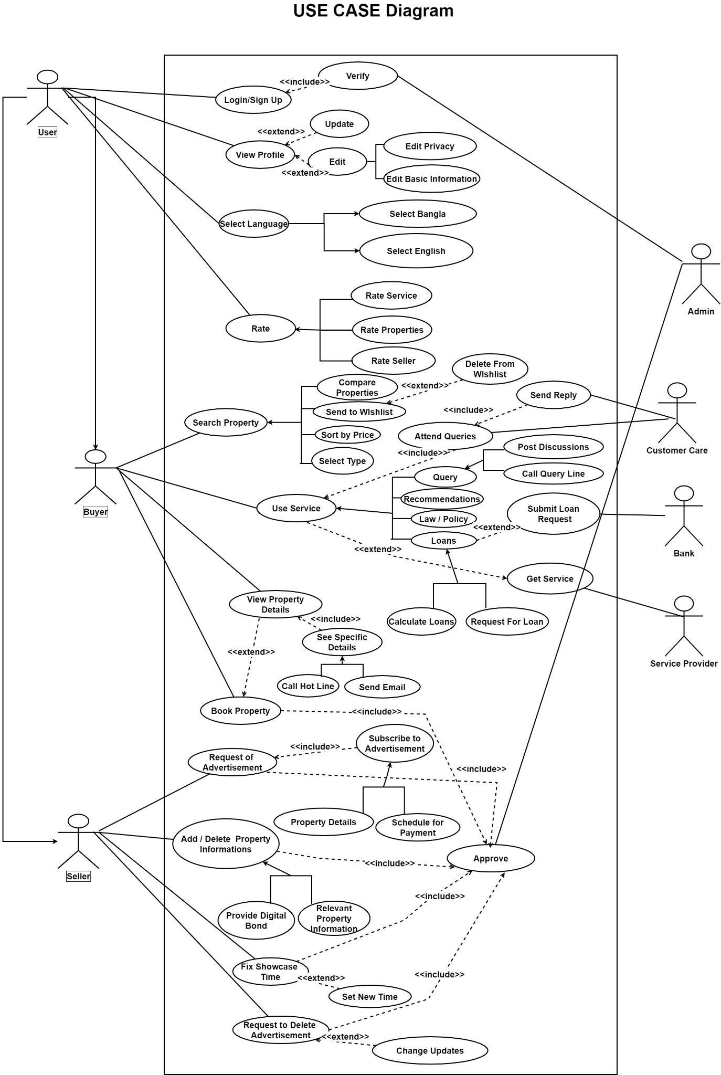
USE Case Diagram
https://drive.google.com/file/d/1RZ387QB2UuG7OsF2DygwWCE3Le6SnCp7/view?usp=sharing

Slide 6
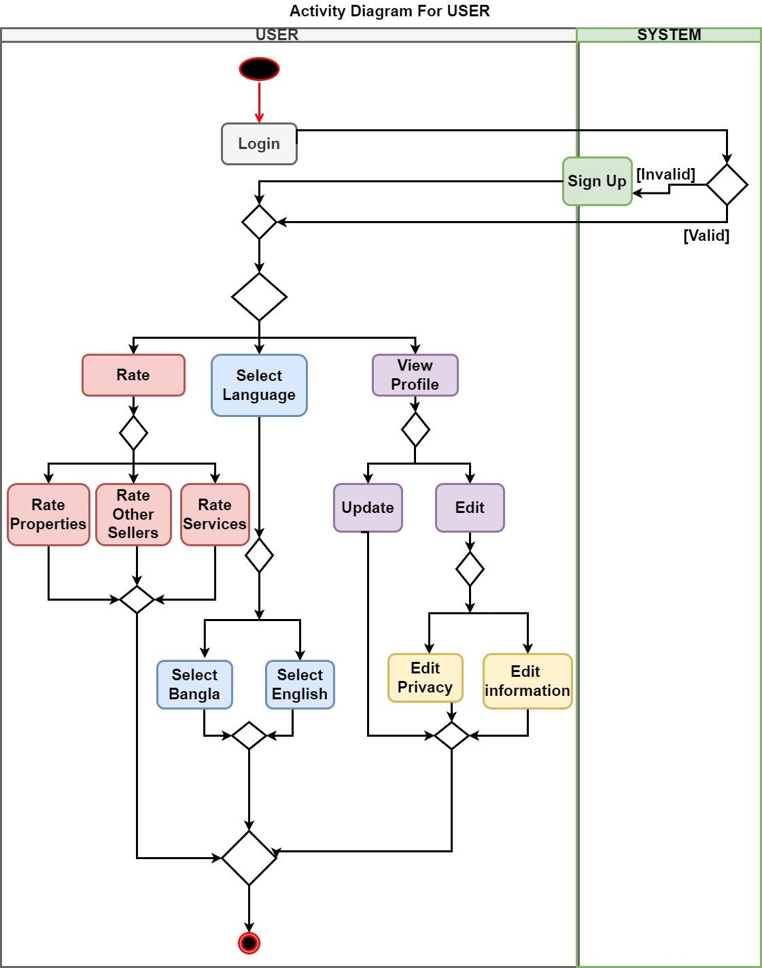
Activity Diagram (USER)
https://drive.google.com/file/d/1eezGUS9YNRiVVQuzon2FSpm691fgLhHV/view?usp=sharing

Slide 7
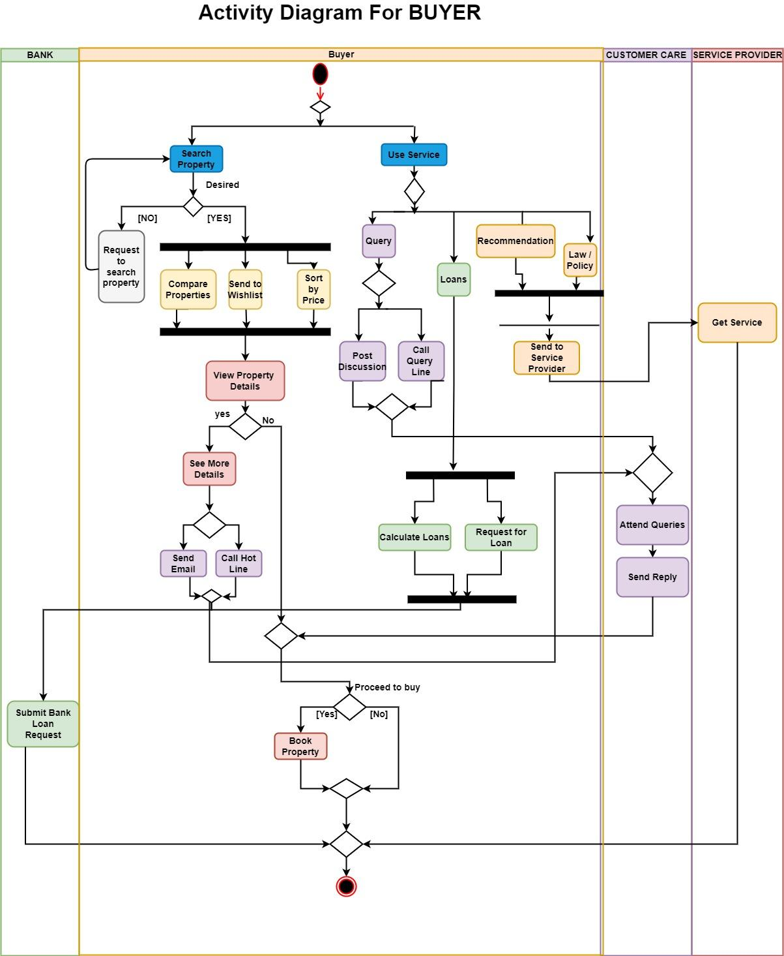
Activity Diagram (BUYER)
https://drive.google.com/file/d/1YNeVZyj6_yTBTWSjcXJBZAx9ID6XjNEd/view?usp=sharing

Slide 8
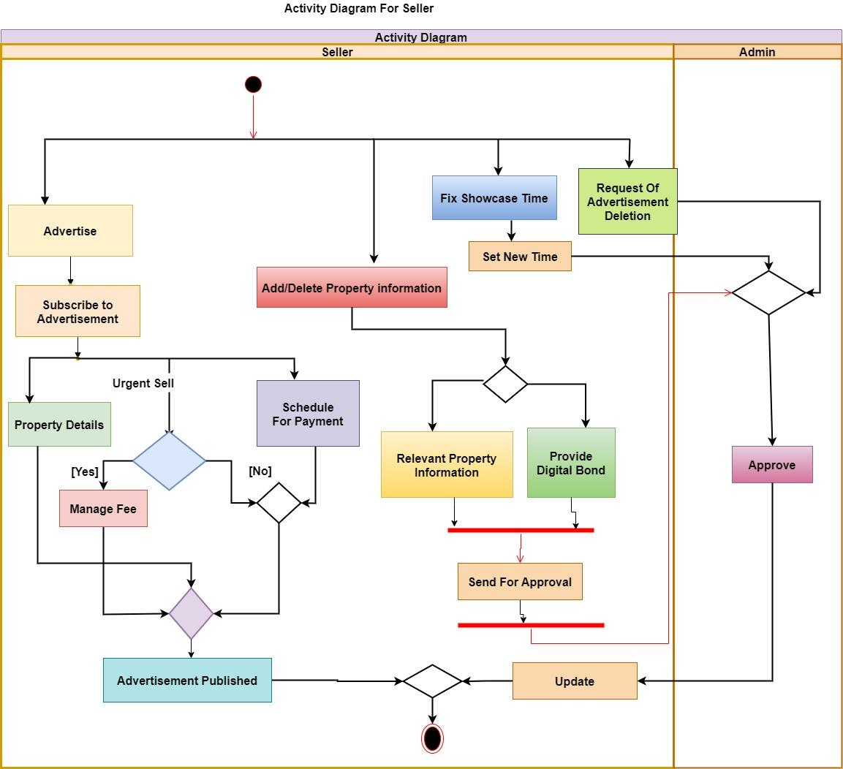
Activity Diagram (SELLER)
https://drive.google.com/file/d/1rNtGPrMtFQAejegzFoiZQV43YrHsHGhe/view?usp=sharing

Slide 9
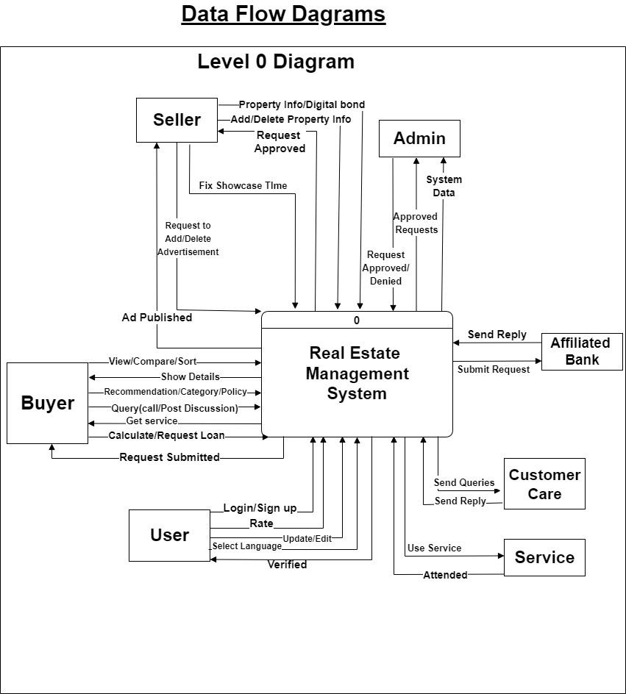
DFD Diagram (Level 0)
https://drive.google.com/file/d/1r8FmEgIU008oUPg1V2tPu7NZ8Q4Exv6j/view?usp=sharing

Slide 10
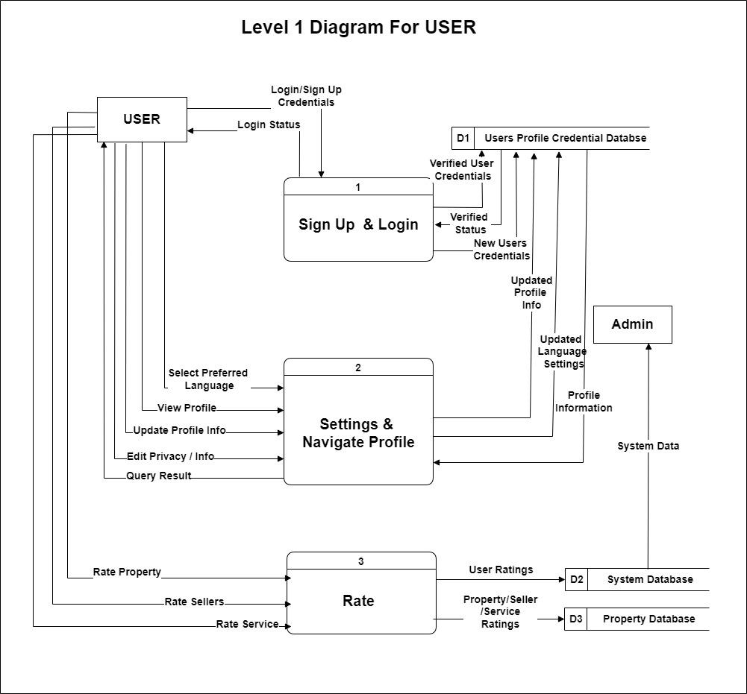
DFD Diagram (Level 1 USER)
https://drive.google.com/file/d/1cMlyH1pE-S5mTWJKz12dgfPiZZUKWnF4/view?usp=sharing

Slide 11
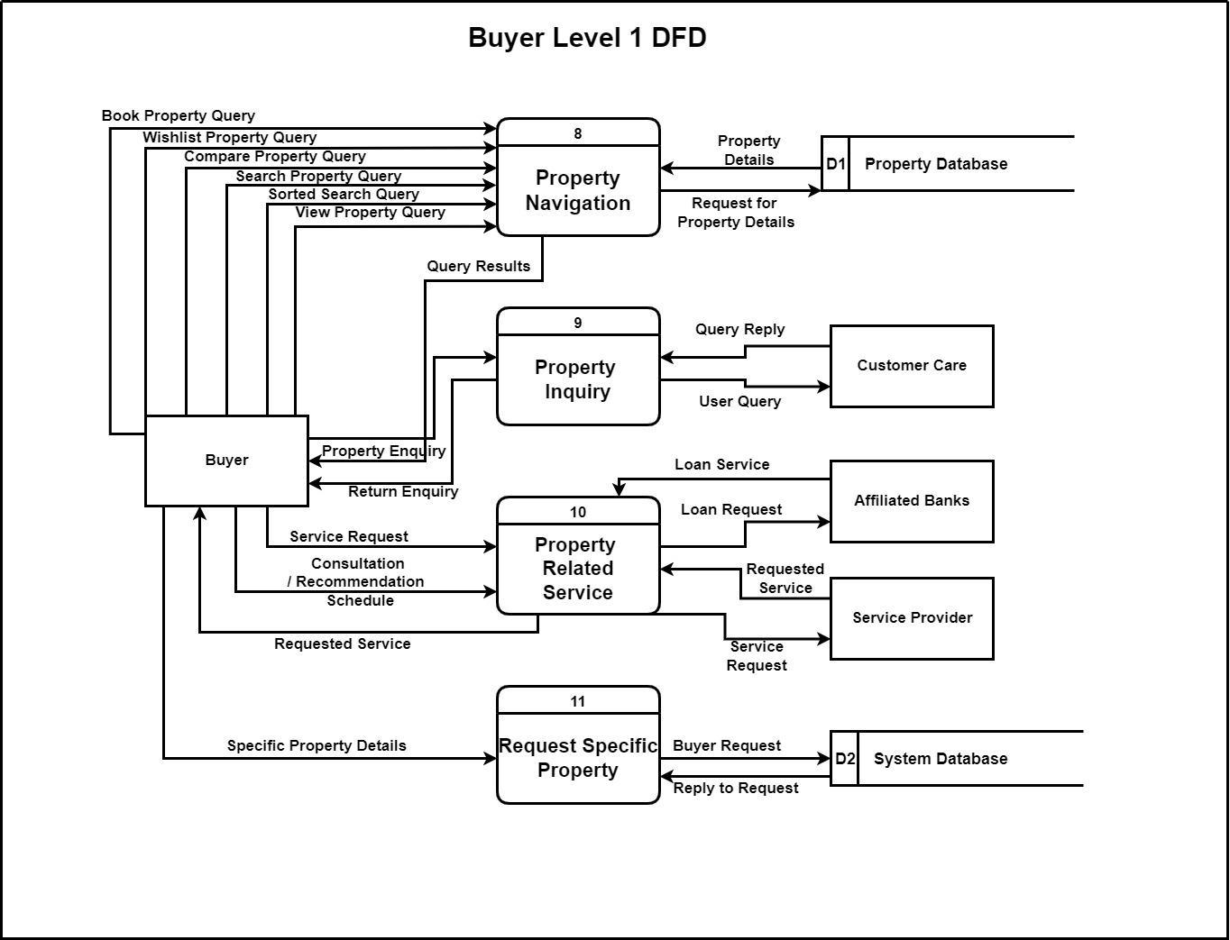
DFD Diagram (Level 1 BUYER)
https://drive.google.com/file/d/1uCkwyE1igRq5MPq2wEP5iQaOsaVTd_hj/view?usp=sharing

Slide 12
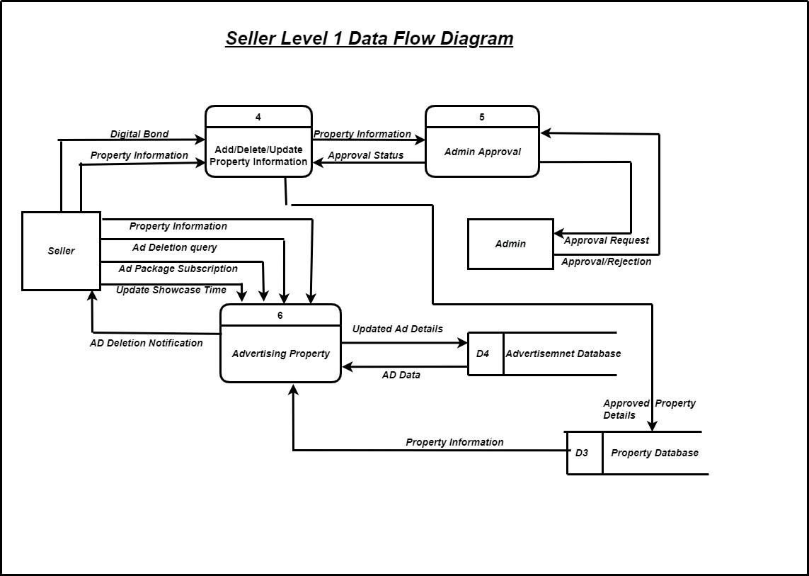
DFD Diagram (Level 1 SELLER)
https://drive.google.com/file/d/1OJvgUg2OTRTaBwYohJg7si8xmdnkpZJ1/view?usp=sharing

Slide 13
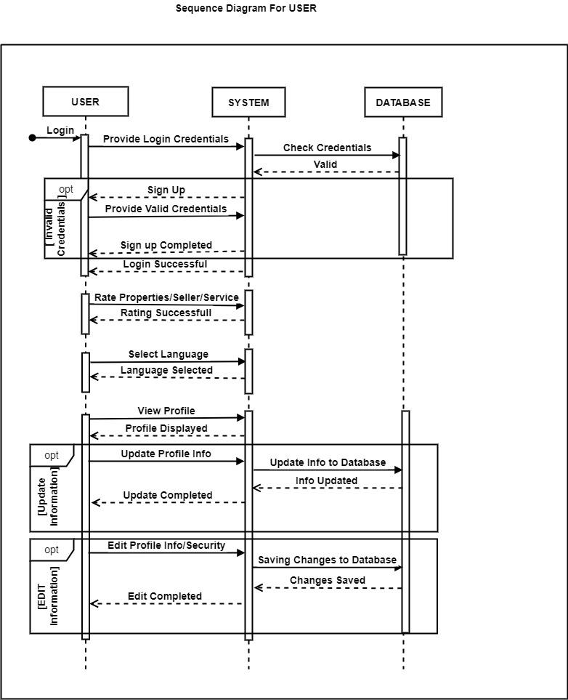
Sequence Diagram (USER)
https://drive.google.com/file/d/1hDP86_LqQYBZttWvAfxsb_g8f_XP0DKP/view?usp=sharing

Slide 14
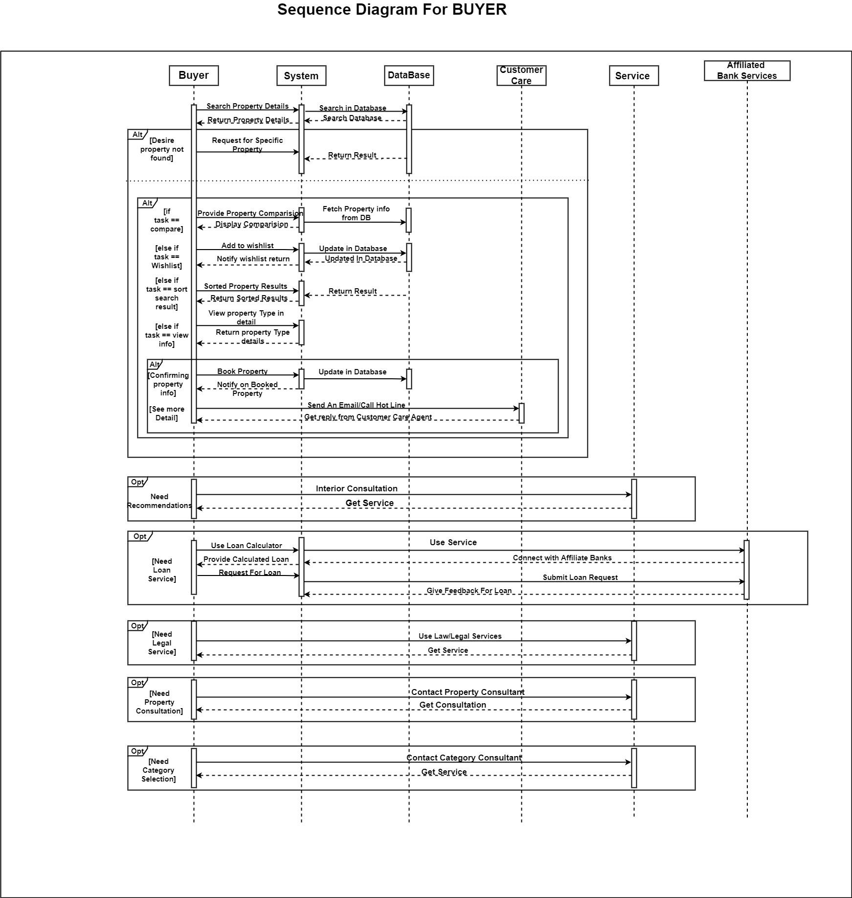
Sequence Diagram (BUYER)
https://drive.google.com/file/d/1ADFojswKq_9sBXTCmr4V4pQuki7R_nlo/view?usp=sharing

Slide 15
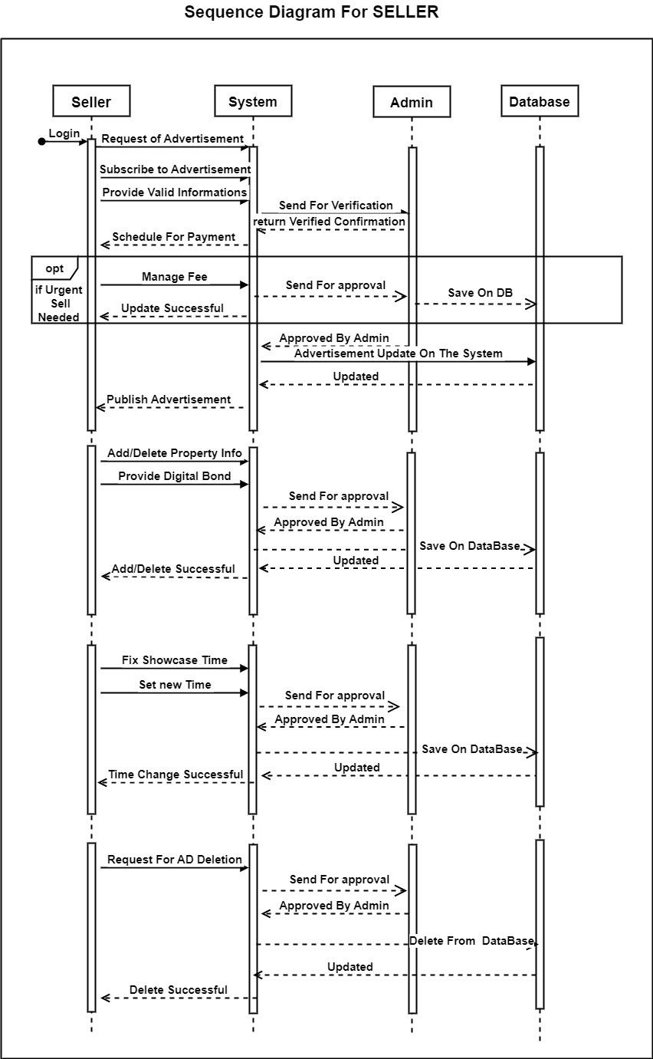
Sequence Diagram (SELLER)
https://drive.google.com/file/d/1fMNEL46ylIFmvqw1Ge6cOQP7RIW6VlMi/view?usp=sharing

Slide 16
Summary and Conclusion
Finally, in the Real Estate management system, we have developed a secure, user-friendly property management system. This system is capable of taking care of each work that needs to be done in the real estate business. The client can log in using a user id and password. This means the unauthorized user cannot enter into the system making it secure. Searching for property help to find their desire property fast.
Online payment scheduling and user verification make it more client friendly. This system would definitely go to reduce labor and make business more profitable and promising to clients.

